Slide 1

Chapter 22
Network Layer:
Delivery, Forwarding,
and Routing
22.<number>
Copyright © The McGraw-Hill Companies, Inc. Permission required for reproduction or display.

Slide 2
22-1 DELIVERY
The network layer supervises the handling of the packets by the underlying physical networks. We define this handling as the delivery of a packet.
Topics discussed in this section:
Direct Versus Indirect Delivery
22.<number>

Slide 3

Figure 22.1 Direct and indirect delivery
22.<number>

Slide 4
22-2 FORWARDING
Forwarding means to place the packet in its route to its destination. Forwarding requires a host or a router to have a routing table. When a host has a packet to send or when a router has received a packet to be forwarded, it looks at this table to find the route to the final destination.
Topics discussed in this section:
Forwarding Techniques
Forwarding Process
Routing Table
22.<number>

Slide 5

Figure 22.2 Route method versus next-hop method
22.<number>

Slide 6

Figure 22.3 Host-specific versus network-specific method
22.<number>

Slide 7

Figure 22.4 Default method
22.<number>

Slide 8

Figure 22.5 Simplified forwarding module in classless address
22.<number>

Slide 9

Note
In classless addressing, we need at least four columns in a routing table.
22.<number>

Slide 10
Example 22.1
Make a routing table for router R1, using the configuration in Figure 22.6.
Solution
Table 22.1 shows the corresponding table.
22.<number>

Slide 11

Figure 22.6 Configuration for Example 22.1
22.<number>

Slide 12

Table 22.1 Routing table for router R1 in Figure 22.6
22.<number>

Slide 13
Example 22.2
Show the forwarding process if a packet arrives at R1 in Figure 22.6 with the destination address 180.70.65.140.
Solution
The router performs the following steps:
1. The first mask (/26) is applied to the destination address.
The result is 180.70.65.128, which does not match the
corresponding network address.
2. The second mask (/25) is applied to the destination
address. The result is 180.70.65.128, which matches the
corresponding network address. The next-hop address
and the interface number m0 are passed to ARP for
further processing.
22.<number>

Slide 14
Example 22.3
Show the forwarding process if a packet arrives at R1 in Figure 22.6 with the destination address 201.4.22.35.
Solution
The router performs the following steps:
1. The first mask (/26) is applied to the destination
address. The result is 201.4.22.0, which does not
match the corresponding network address.
2. The second mask (/25) is applied to the destination address. The result is 201.4.22.0, which does not match the corresponding network address (row 2).
22.<number>

Slide 15
Example 22.3 (continued)
3. The third mask (/24) is applied to the destination
address. The result is 201.4.22.0, which matches the
corresponding network address. The destination
address of the packet and the interface number m3 are
passed to ARP.
22.<number>
Notes:
ARP: Address Resolution protocol

Slide 16
Example 22.4
Show the forwarding process if a packet arrives at R1 in Figure 22.6 with the destination address 18.24.32.78.
Solution
This time all masks are applied, one by one, to the destination address, but no matching network address is found. When it reaches the end of the table, the module gives the next-hop address 180.70.65.200 and interface number m2 to ARP. This is probably an outgoing package that needs to be sent, via the default router, to someplace else in the Internet.
22.<number>

Slide 17
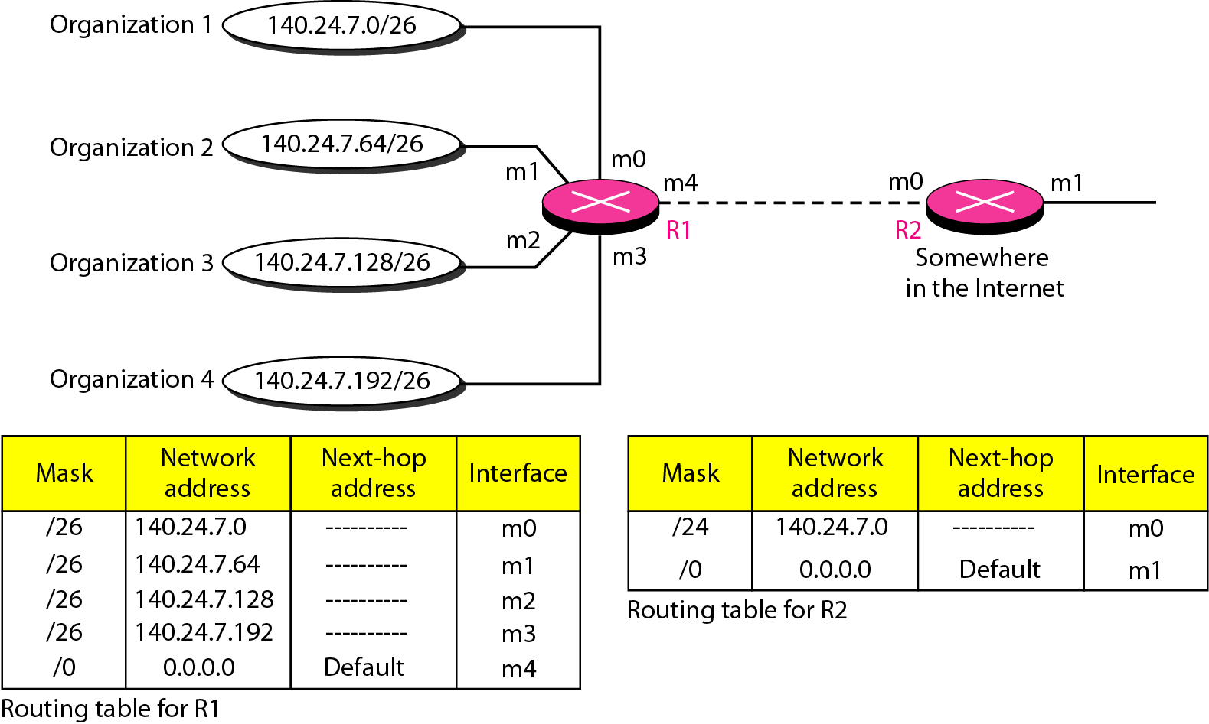
Figure 22.7 Address aggregation
22.<number>

Slide 18
Example 22.5
As an example of hierarchical routing, let us consider Figure 22.9. A regional ISP is granted 16,384 addresses starting from 120.14.64.0. The regional ISP has decided to divide this block into four subblocks, each with 4096 addresses. Three of these subblocks are assigned to three
local ISPs; the second subblock is reserved for future use. Note that the mask for each block is /20 because the original block with mask /18 is divided into 4 blocks.
The first local ISP has divided its assigned subblock into 8 smaller blocks and assigned each to a small ISP. Each small ISP provides services to 128 households, each using four addresses.
22.<number>

Slide 19
Example 22.5 (continued)
The second local ISP has divided its block into 4 blocks and has assigned the addresses to four large organizations.
The third local ISP has divided its block into 16 blocks and assigned each block to a small organization. Each small organization has 256 addresses, and the mask is /24.
There is a sense of hierarchy in this configuration. All routers in the Internet send a packet with destination address 120.14.64.0 to 120.14.127.255 to the regional ISP.
22.<number>

Slide 20
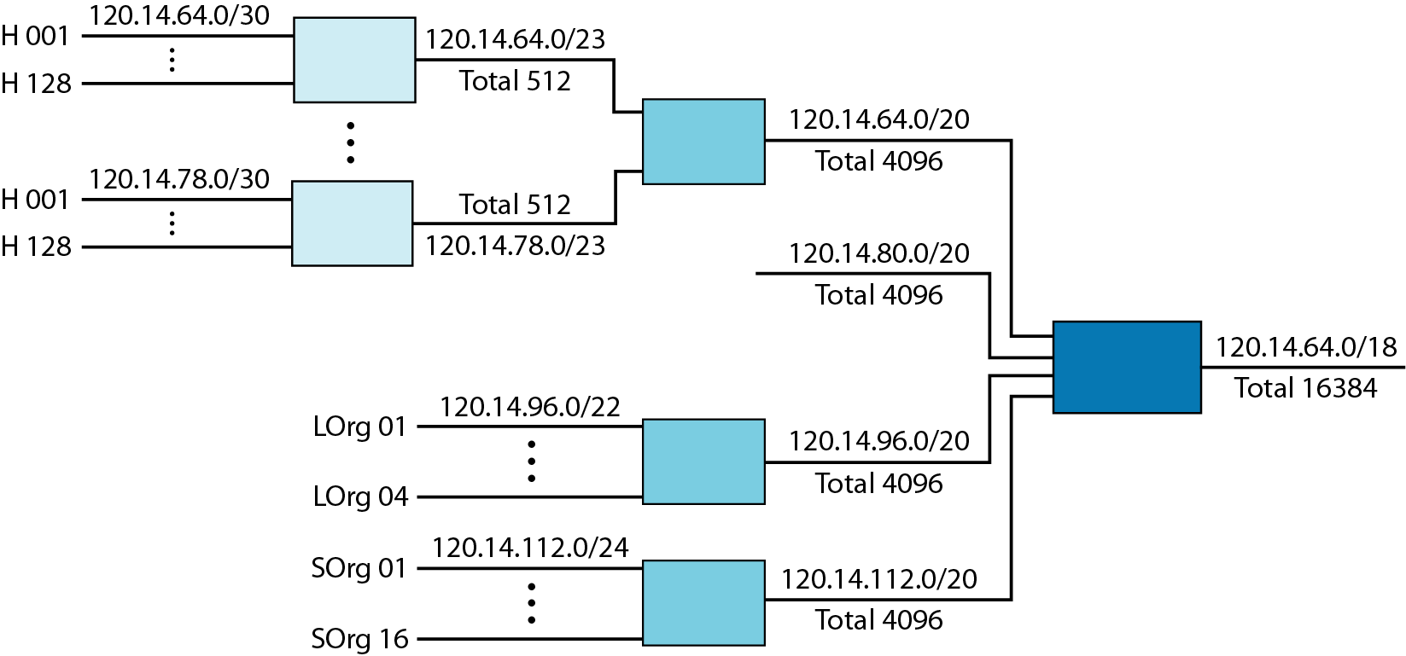
Figure 22.9 Hierarchical routing with ISPs
22.<number>

Slide 21
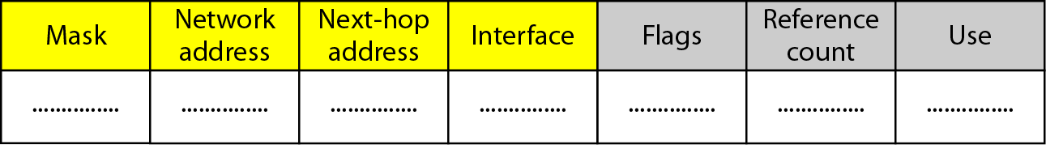
Figure 22.10 Common fields in a routing table
22.<number>

Slide 22
22-3 UNICAST ROUTING PROTOCOLS
A routing table can be either static or dynamic. A static table is one with manual entries. A dynamic table is one that is updated automatically when there is a change somewhere in the Internet. A routing protocol is a combination of rules and procedures that lets routers in the Internet inform each other of changes.
Topics discussed in this section:
Optimization
Intra- and Interdomain Routing
Distance Vector Routing and RIP
Link State Routing and OSPF
Path Vector Routing and BGP
22.<number>

Slide 23

Figure 22.12 Autonomous systems
22.<number>
Notes:
independent

Slide 24

Figure 22.13 Popular routing protocols
22.<number>

Slide 25

Figure 22.14 Distance vector routing tables
22.<number>

Slide 26

Figure 22.15 Initialization of tables in distance vector routing
22.<number>

Slide 27
Note
In distance vector routing, each node shares its routing table with its
immediate neighbors periodically and when there is a change.
22.<number>

Slide 28

Figure 22.16 Updating in distance vector routing
22.<number>

Slide 29

Figure 22.17 Two-node instability
22.<number>

Slide 30
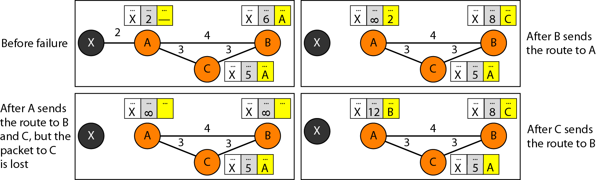
Figure 22.18 Three-node instability
22.<number>

Slide 31

Figure 22.19 Example of a domain using RIP
22.<number>

Slide 32

Figure 22.20 Concept of link state routing
22.<number>

Slide 33

Figure 22.21 Link state knowledge
22.<number>

Slide 34

Figure 22.22 Dijkstra algorithm
22.<number>

Slide 35

Figure 22.23 Example of formation of shortest path tree
22.<number>

Slide 36

Table 22.2 Routing table for node A
22.<number>

Slide 37

Figure 22.24 Areas in an autonomous system
22.<number>

Slide 38
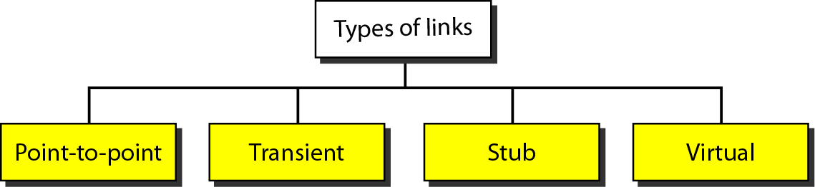
Figure 22.25 Types of links
22.<number>

Slide 39
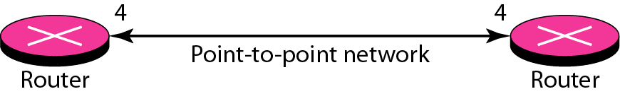
Figure 22.26 Point-to-point link
22.<number>

Slide 40
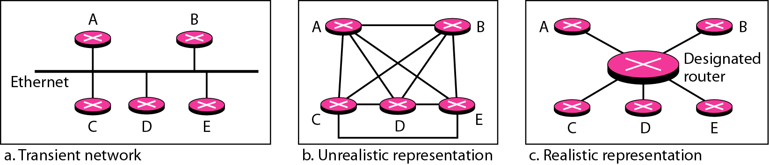
Figure 22.27 Transient link
22.<number>

Slide 41
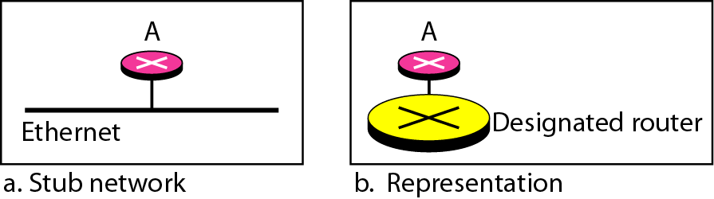
Figure 22.28 Stub link
22.<number>

Slide 42
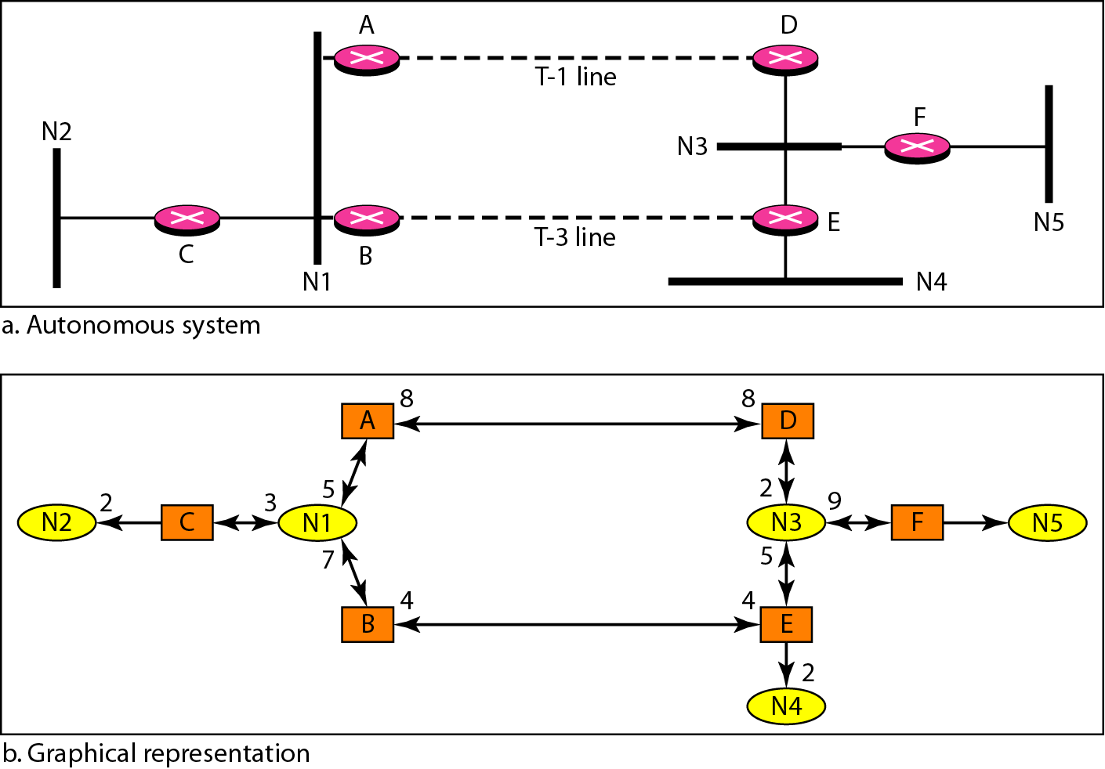
Figure 22.29 Example of an AS and its graphical representation in OSPF
22.<number>

Slide 43
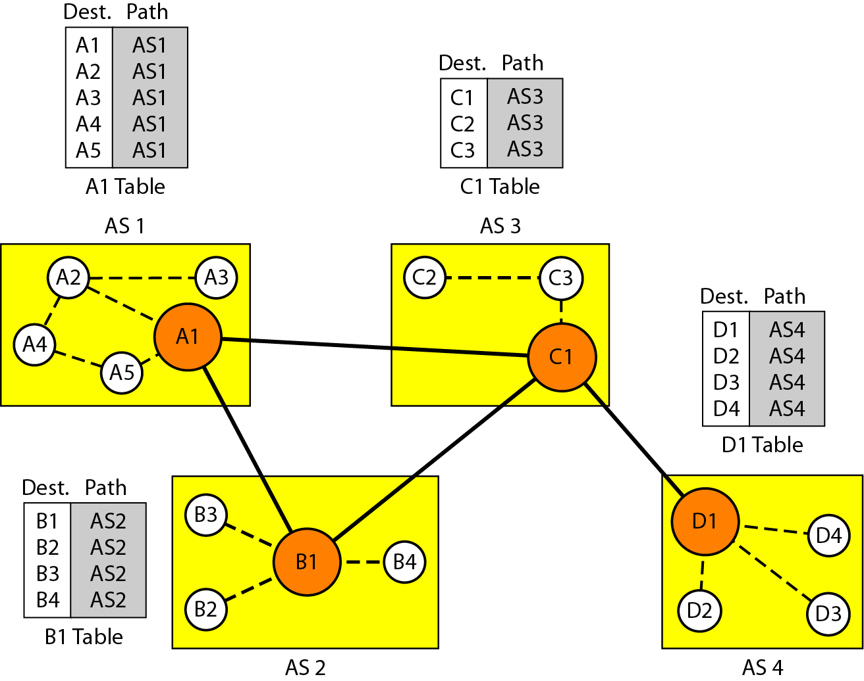
Figure 22.30 Initial routing tables in path vector routing
22.<number>

Slide 44
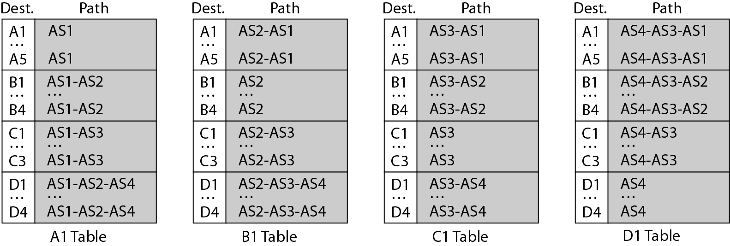
Figure 22.31 Stabilized tables for three autonomous systems
22.<number>

Slide 45
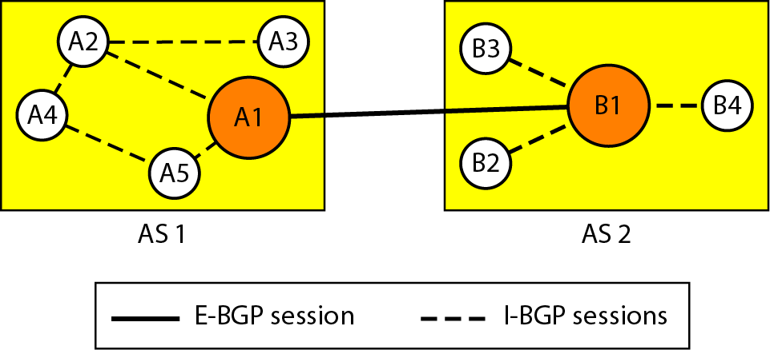
Figure 22.32 Internal and external BGP sessions
22.<number>

